Slide 1
Bayesian Phylogenetics
Slides are a taken from presentations by
Frederick Ronquist &
Anders Gorm Pedersen

Slide 2
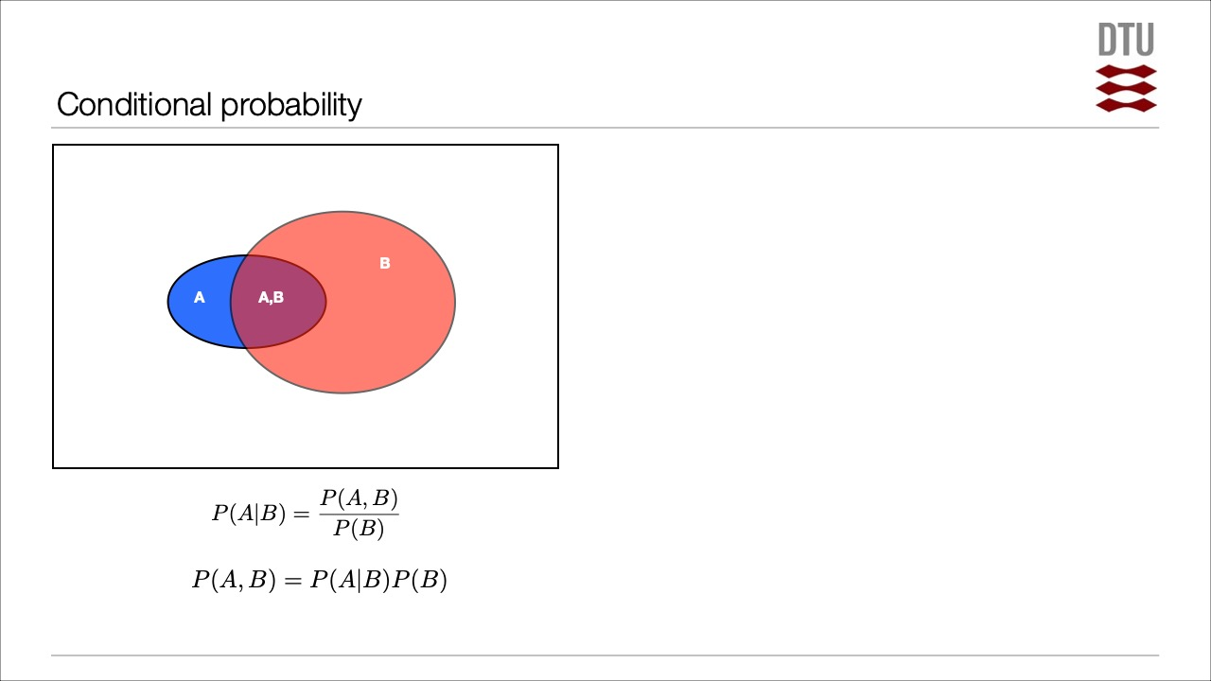
Joint probability: p(A and B). The probability of event A and event B occurring. It is the probability of the intersection of two or more events. The probability of the intersection of A and B may be written p(A ∩ B). Example: the probability that a card is a four and red =p(four and red) = 2/52=1/26. (There are two red fours in a deck of 52, the 4 of hearts and the 4 of diamonds).
Conditional probability: p(A|B) is the probability of event A occurring, given that event B occurs. Example: given that you drew a red card, what’s the probability that it’s a four (p(four|red))=2/26=1/13. So out of the 26 red cards (given a red card), there are two fours so 2/26=1/13.

Slide 3
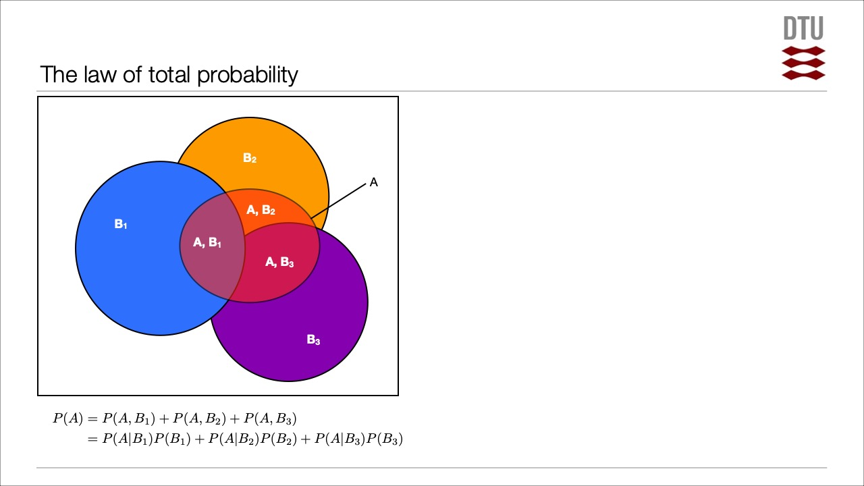

Slide 10
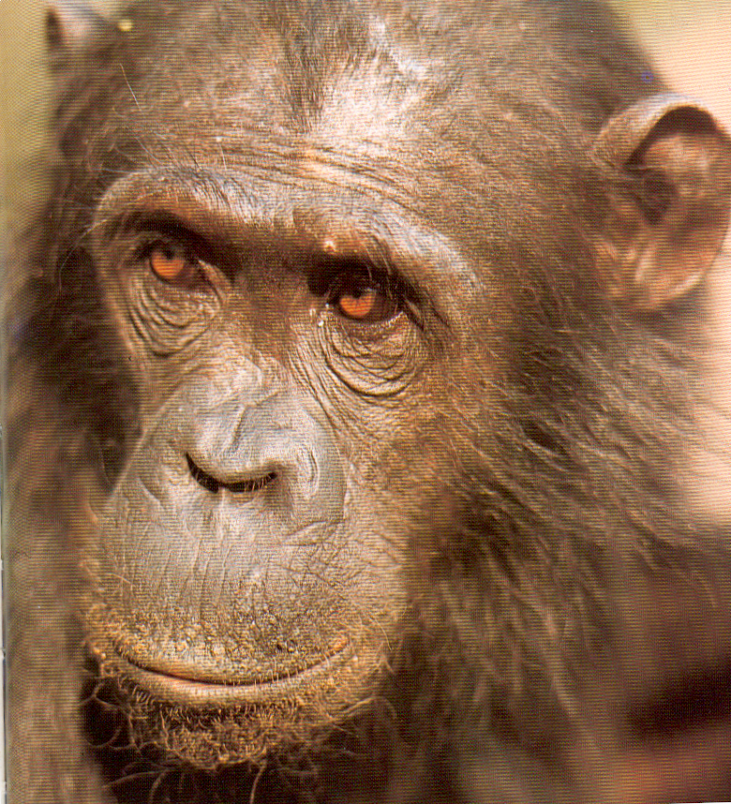
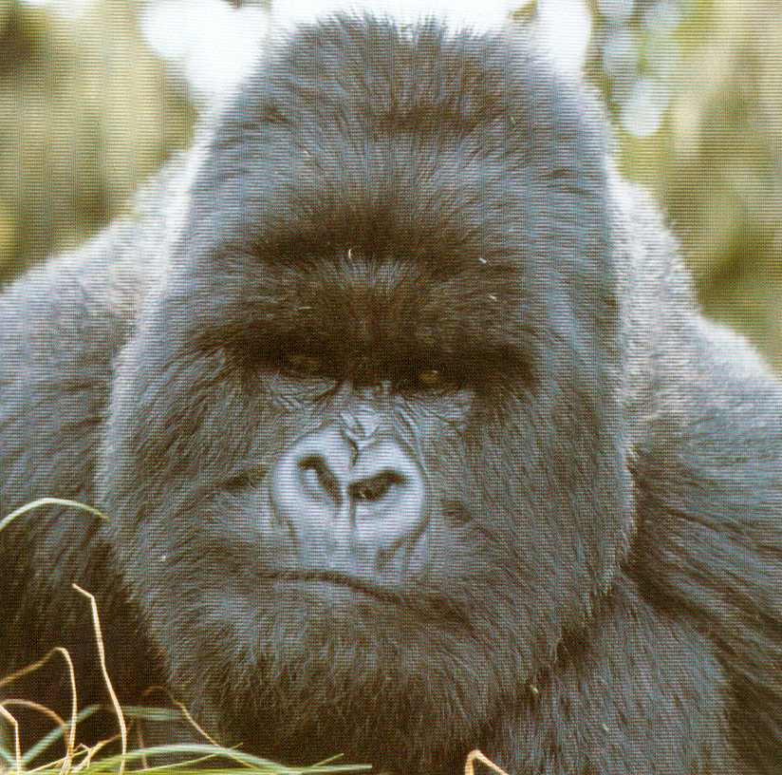
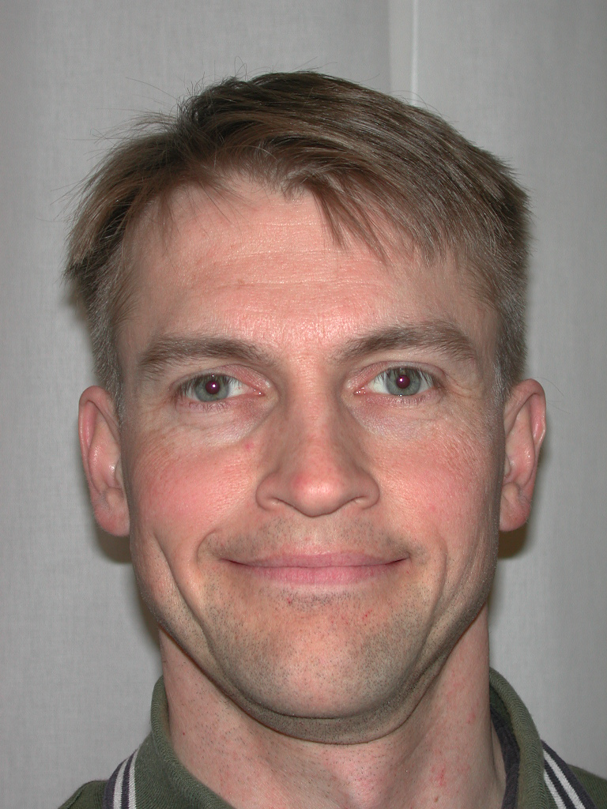
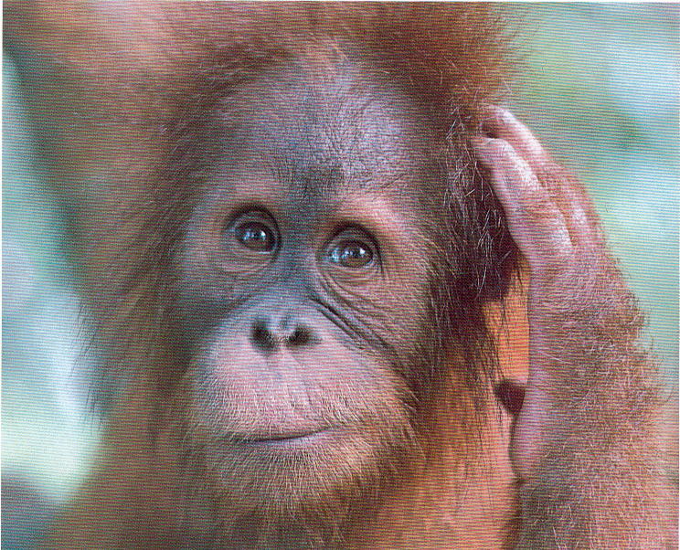
Infer relationships among three species:
Outgroup:

Slide 11
Three possible trees (topologies):
A
C
B

Slide 12
Model (Hypotheses)
A
B
C
1.0
probability
Prior distribution
Data (observations)
1.0
probability
Posterior distribution

Slide 13
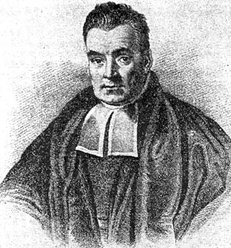
Bayes’ theorem
X = Data
Θ = Model parameters
Posterior
distribution
Prior distribution
”Likelihood”
Normalizing constant

Slide 14
Model: topology AND branch lengths
Parameters
A
C
topology
branch lengths
(expected amount of change)
B
D

Slide 15
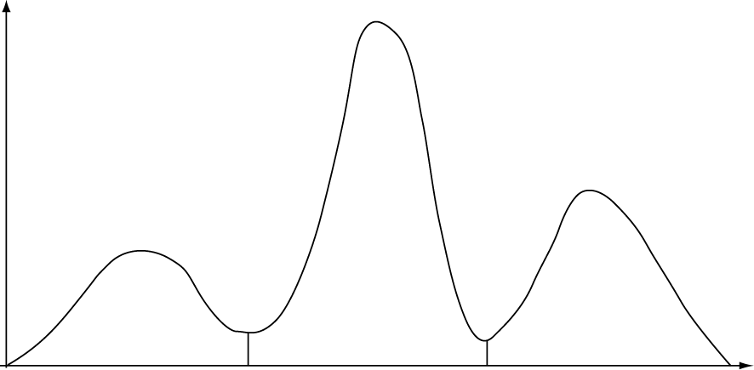
Posterior probability distribution
Posterior probability
tree 1
tree 2
tree 3
Parameter space

Slide 16
We can focus on any parameter of interest (there are no nuisance parameters) by marginalizing the posterior over the other parameters (integrating out the uncertainty in the other parameters)
20%
48%
32%
tree 1
tree 2
tree 3
(Percentages denote marginal probability distribution on trees)

Slide 17
Why is it called marginalizing?
trees
joint probabilities
branch length vectors
marginal probabilities

Slide 18
Marginal probability: the probability of an event occurring (p(A)), it may be thought of as an unconditional probability. It is not conditioned on another event. Example: the probability that a card drawn is red (p(red) = 0.5). Another example: the probability that a card drawn is a 4 (p(four)=1/13).

Slide 19
Markov chain Monte Carlo
Start at an arbitrary point
Make a small random move
Calculate height ratio (r) of new state to old state:
r > 1 -> new state accepted
r < 1 -> new state accepted with probability r. If new state not accepted, stay in the old state
Go to step 2
always accept
2a
1
The proportion of time the MCMC procedure samples from a particular parameter region is an estimate of that region’s posterior probability density
2b
accept sometimes
20 %
48 %
32 %
tree 1
tree 2
tree 3

Slide 20
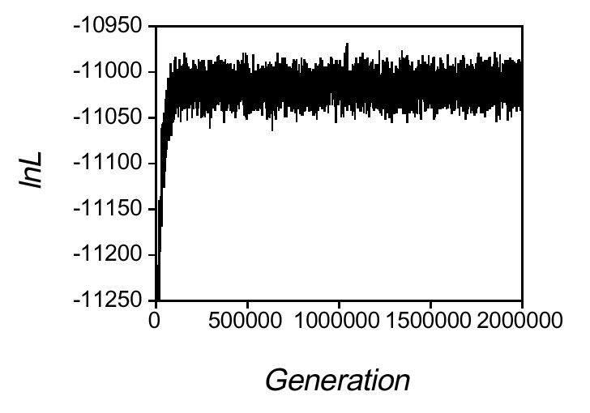
stationary phase sampled with thinning
(rapid mixing essential)
burn-in

Slide 21
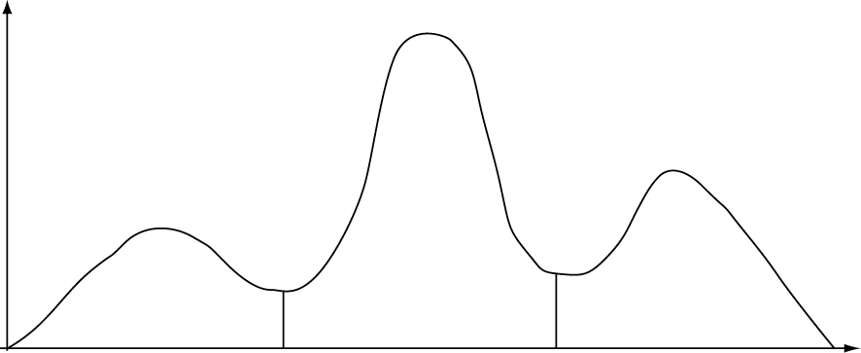
Metropolis-coupled Markov chain Monte Carlo
a. k. a.
MCMCMC
a. k. a.
(MC)³
cold chain
T
heated chain

Slide 22
cold chain
hot chain

Slide 23
cold chain
hot chain

Slide 24
cold chain
hot chain

Slide 25
cold chain
unsuccessful swap
hot chain

Slide 26
cold chain
hot chain

Slide 27
cold chain
hot chain

Slide 28
cold chain
successful swap
hot chain

Slide 29
cold chain
hot chain

Slide 30
cold chain
hot chain

Slide 31
cold chain
successful swap
hot chain

Slide 32
cold chain
hot chain

Slide 33
Assessing Convergence
Plateau in the trace plot
Look at sampling behavior within the run (autocorrelation times, estimated sample size etc)
Compare windows within the same run
Compare independent runs with different, randomly chosen starting points

Slide 34
Improving Convergence
(Only if convergence diagnostics indicate problem!)
Change tuning parameters of proposals to bring acceptance rate into the range 10 % to 50 %
Propose changes to ‘difficult’ parameters more often
Use different proposal mechanisms
Increase the number of chains
Run the analysis longer
Make the model more realistic
Start with reasonable trees
Perform at least two independent analyses starting from different random trees

Slide 35
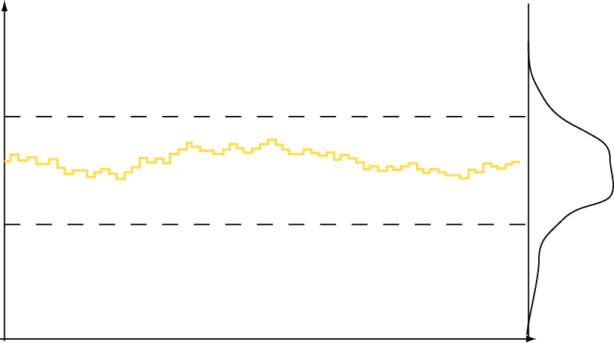
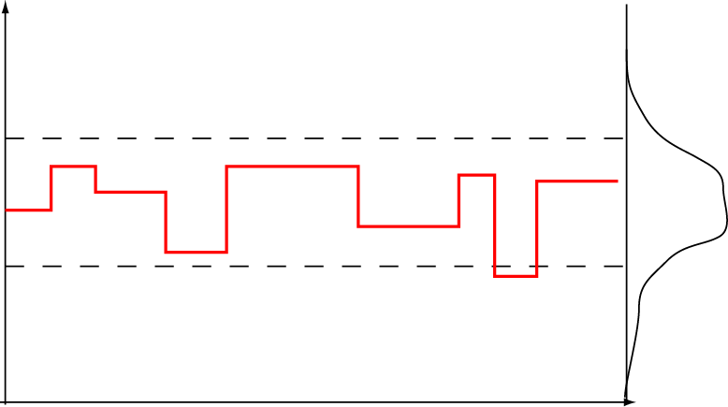
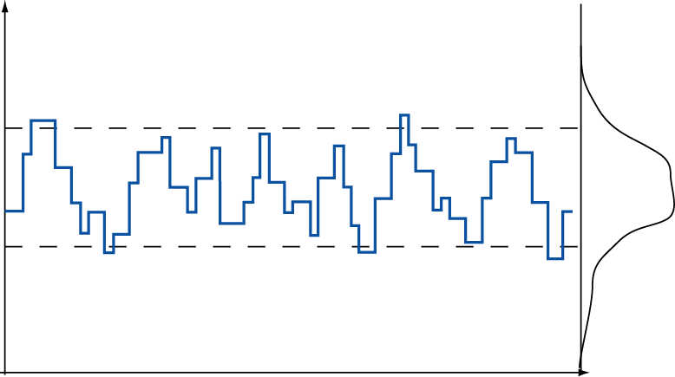
Target distribution
Too modest proposals
Acceptance rate too high
Poor mixing
Too bold proposals
Acceptance rate too low
Poor mixing
Sampled value
Moderately bold proposals
Acceptance rate intermediate
Good mixing

Slide 36
Bayes’ theorem
Marginal likelihood (of the model)
We have implicitly conditioned on a model:

Slide 37
Bayesian Model Choice
Posterior model odds:
Bayes factor:

Slide 38
Bayesian Model Choice
The normalizing constant in Bayes’ theorem, the marginal probability of the model, f(X) or f(X|M), can be used for model choice
f(X|M) can be estimated using stepping stone sampling or path sampling techniques (time consuming) DO NOT USE THE harmonic mean of the likelihood values from the MCMC run
Any models can be compared: nested, non-nested, data-derived
Critical values in Kass and Raftery (1997)

Slide 39
Bayes Factor Comparisons
Interpretation of the Bayes factor
2ln(B₁₀) | B₁₀ | Evidence against M₀
0 to 2 | 1 to 3 | Not worth more than a bare mention
2 to 6 | 3 to 20 | Positive
6 to 10 | 20 to 150 | Strong
> 10 | > 150 | Very strong

Slide 40
Why Bayesian?
Priors: accumulate scientific knowledge
Easy to deal with complex models, and current models need to be improved
Computational efficiency: datasets are getting larger
Convergence diagnostics to detect problems with convergence
Model testing with Bayes factors
Sampling across model space

Slide 41
BEAST
is a cross-platform program for Bayesian MCMC analysis of molecular sequences
entirely orientated towards rooted, time-measured phylogenies inferred using strict or relaxed molecular clock models
can be used as a method of reconstructing phylogenies, but is also a framework for testing evolutionary hypotheses without conditioning on a single tree topology
uses MCMC to average over tree space, so that each tree is weighted proportional to its posterior probability

Slide 42
BEAST requirements
Data - your multiple sequence alignment
Clock calibrations (tip dates or fossil data)
Model
Nucleotide substitution models (most often HKY or GTR)
Molecular clock model (Uncorrelated lognormal Relaxed Clock)
Priors
Coalescent (Bayesian Skyride)
Clock Rate Prior (informed experimentally or from literature)

Slide 43
Running BEAST
1) setting up xml file (beauti)
2) running xml file (beast)
3) evaluating the performance of the run (Tracer)
4) comparing models, obtaining estimates of parameters (Tracer)
5) summarizing the tree distribution (TreeAnnotator)
6) viewing MCC tree (Figtree)

Slide 44
Citations
The recommended citation for this program is:
Suchard MA, Lemey P, Baele G, Ayres DL, Drummond AJ & Rambaut A (2018) Bayesian phylogenetic and phylodynamic data integration using BEAST 1.10 Virus Evolution 4
To cite the relaxed clock model in BEAST:
Drummond AJ, Ho SYW, Phillips MJ & Rambaut A (2006) PLoS Biology 4, e88
To cite the Bayesian Skyline model in BEAST:
Drummond AJ, Rambaut A & Shapiro B and Pybus OG (2005) Mol Biol Evol 22, 1185-1192
The original MCMC paper was:
Drummond AJ, Nicholls GK, Rodrigo AG & Solomon W (2002) Genetics 161, 1307-1320

Slide 45
Island GTR model
B
C
A
D
Circle size represents carrying capacity
Thickness of arrows represents dispersal rate

Slide 46
Model
distribution
DNA data 1
T₁
GTR₁
μ₁
m₁
DNA data 2
T₂
GTR₂
μ₂
m₂
IM
IM – island model
μ_{i} – mutation rate
m_{i} - dispersal rate
DNA data 3
T₃
GTR₃
μ₃
m₃

Slide 47
Canary Islands – GTR model
D
B
C
A
Western
Central
Eastern
Mainland

